Slide 1
ReneWind
Data based prediction model : Reduce Maintenance cost

Slide 2

Background
Predictive maintenance uses sensor information and analysis methods to measure and predict degradation and future component capability.
The idea behind predictive maintenance is that failure patterns are predictable and if component failure can be predicted accurately and the component is replaced before it fails, the costs of operation and maintenance will be much lower.
The sensors fitted across different machines involved in the process of energy generation collect data related to various environmental factors (temperature, humidity, wind speed, etc.) and additional features related to various parts of the wind turbine (gearbox, tower, blades, break, etc.).
“ReneWind” is a company working on improving the machinery/processes involved in the production of wind energy using machine learning and has collected data of generator failure of wind turbines using sensors.

Slide 3
Business Problem Overview and Solution Approach
“ReneWind” has shared a ciphered version of the data, Data has 40 predictors, 40000 observations in the training set and 10000 in the test set.
Objective
The objective is to build various classification models, tune them and find the best one that will help identify failures so that the generator could be repaired before failing/breaking and the overall maintenance cost of the generators can be brought down.
“1” in the target variables should be considered as “failure” and “0” will represent “No failure”.
The nature of predictions made by the classification model will translate as follows:
True positives (TP) are failures correctly predicted by the model.
False negatives (FN) are real failures in the generator of wind turbine where there is no detection by the model.
False positives (FP) are failure detections in the generator of the wind turbine where actually there is no failure.
So, the maintenance cost associated with the model would be:
Maintenance cost = TP*(Repair cost) + FN*(Replacement cost) + FP*(Inspection cost)

Slide 4
Business Problem Overview and Solution Approach
So, the maintenance cost associated with the model would be:
Maintenance cost = TP*(Repair cost) + FN*(Replacement cost) + FP*(Inspection cost)
where,
Replacement cost = $40,000
Repair cost = $15,000
Inspection cost = $5,000
Here the objective is to reduce the maintenance cost so, we want a metric that could reduce the maintenance cost.
The minimum possible maintenance cost = Actual failures*(Repair cost) = (TP + FN)*(Repair cost)
And the maintenance cost associated with model = TP*(Repair cost) + FN*(Replacement cost) + FP*(Inspection cost)
So, we will try to maximize the ratio of minimum possible maintenance cost and the maintenance cost associated with the model.
The value of this ratio will lie between 0 and 1, the ratio will be 1 only when the maintenance cost associated with the model will be equal to the minimum possible maintenance cost.

Slide 5
Data Overview
Variable | Description
40 Columns | ciphered version of the data, as the data collected through sensors is confidential
Observations | Variables
Training set 40000 | 40
Test set 10000 | 40
Missing values
The data set has missing values and, in this case, the mean imputer is used to impute missing values

Slide 6
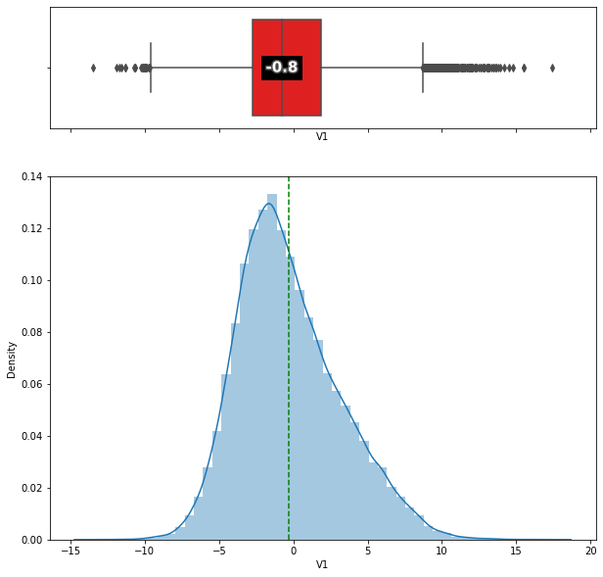
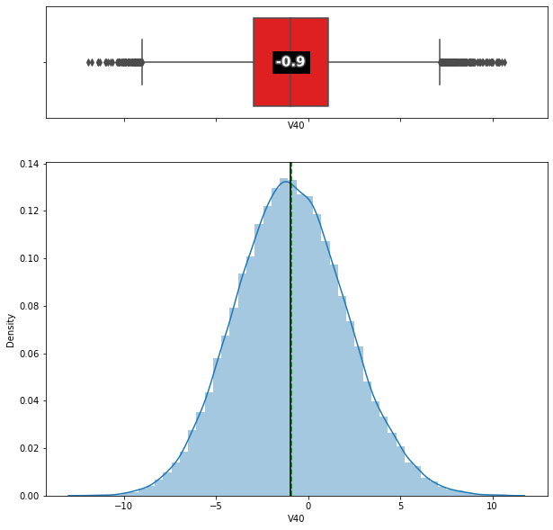
Exploratory Data Analysis
Most of the variables exhibit almost near normal distribution.
The distribution of V1 and V40 as an example.

Slide 7
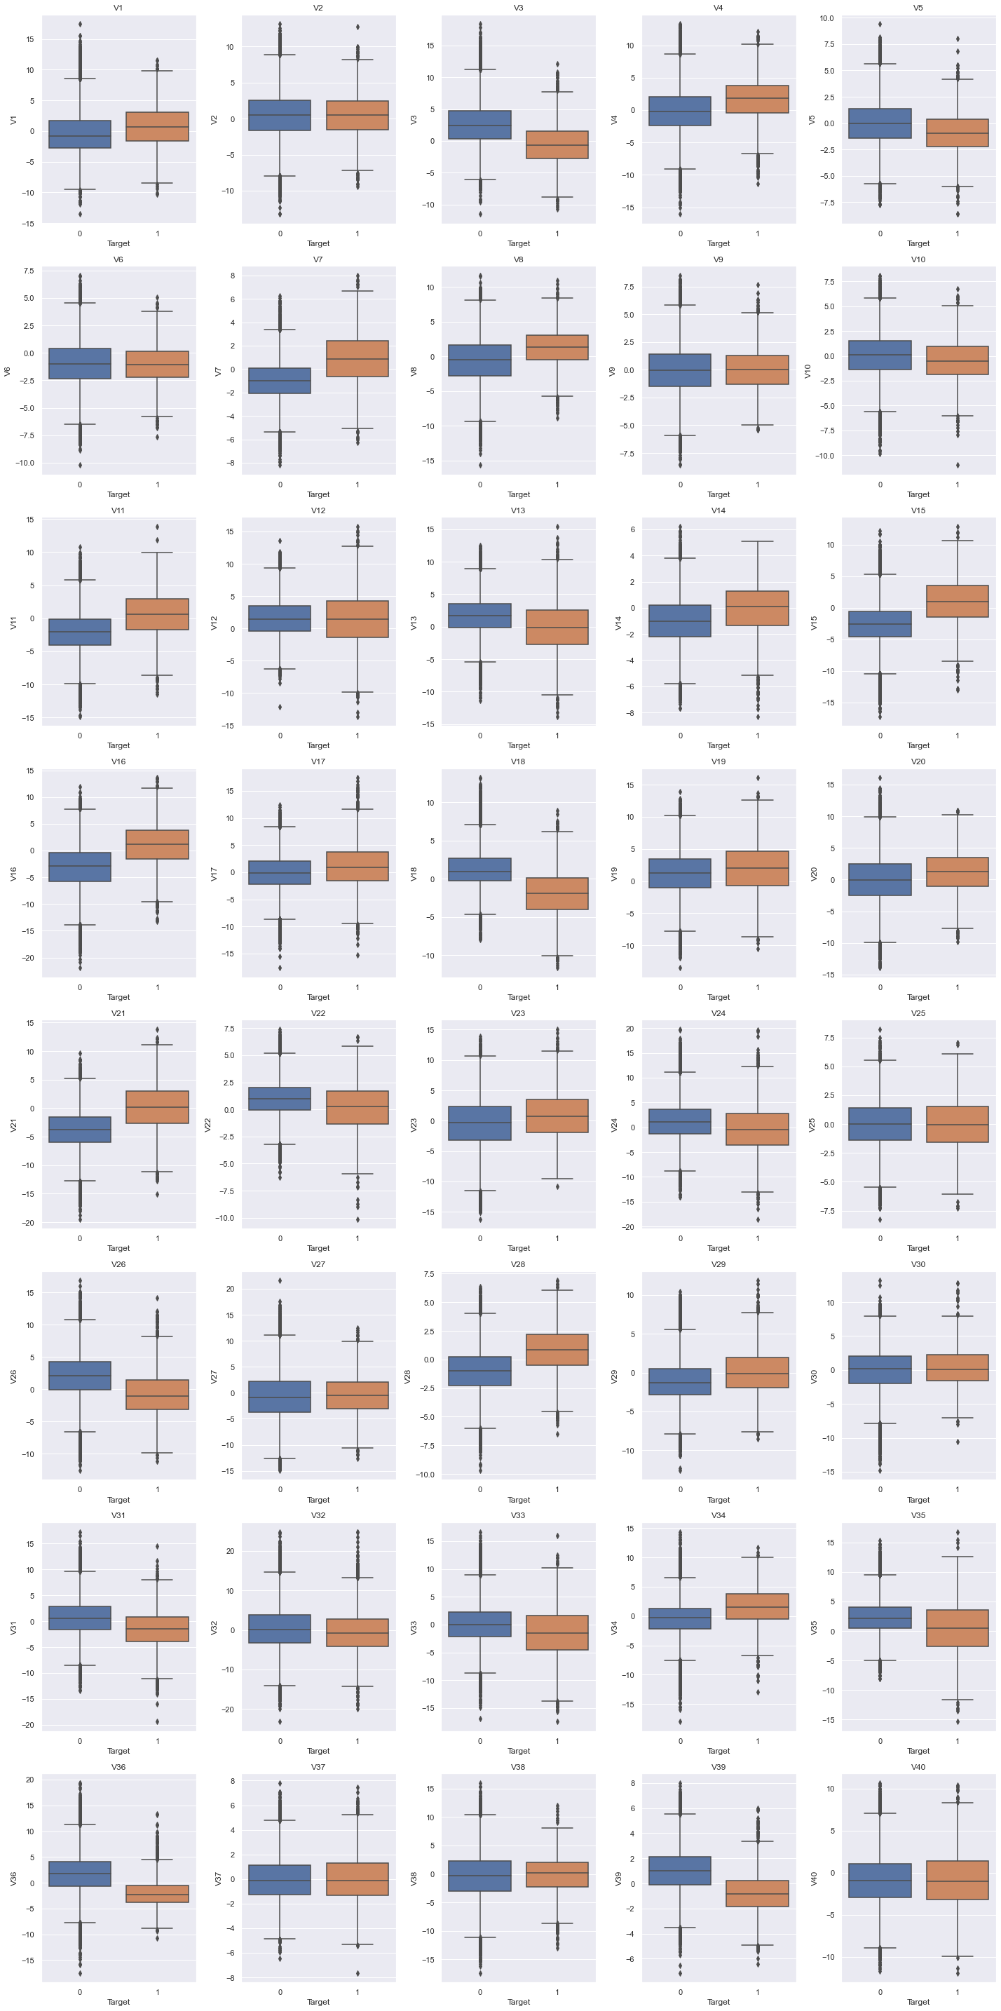
EDA
All the 40 variable have a near normal distribution.
There are outliers.
No specific treatment for the outliers as they are part of the natural data.

Slide 8
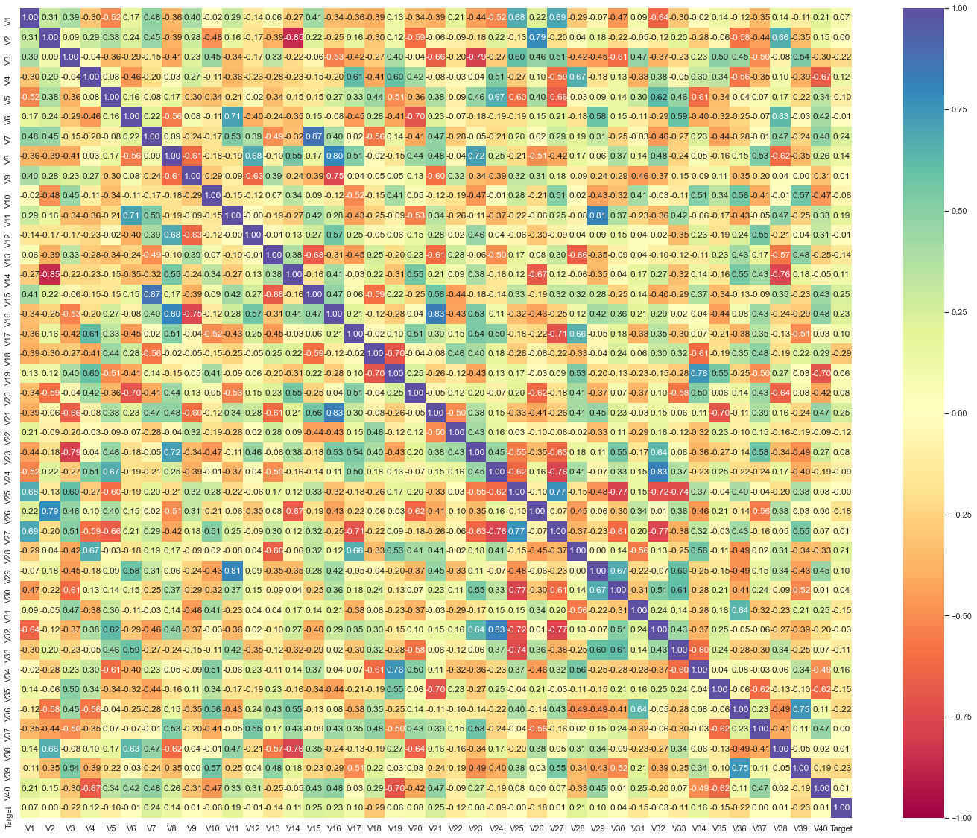
EDA
There is no specific correlation of dependent variables w.r.t to Target variable.
There are some variable that have strong positive and negative correlation.

Slide 9
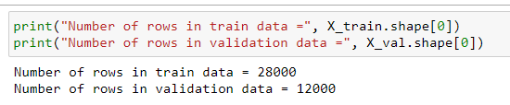
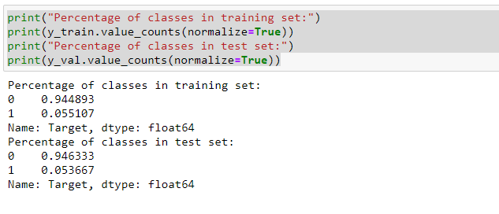
Model Building – The data set is imbalanced

Slide 10
Model Building – With Original Data
Cross-Validation Performance: cv=10
On Training Data
LogisticRegression: 52.35892533471536
DecisionTree: 65.10054473324213
Random forest: 71.53861239850332
Bagging: 69.43885217772146
Adaboost: 58.79589095944772
GBM: 68.1172554037155
Xgboost: 77.45266458451022
Performance on Validation data:
LogisticRegression: 53.047775947281714
DecisionTree: 67.2
Random forest: 72.93318233295584
Bagging: 70.38251366120218
Adaboost: 60.2996254681648
GBM: 68.58359957401491
Xgboost: 77.52808988764045

Slide 11
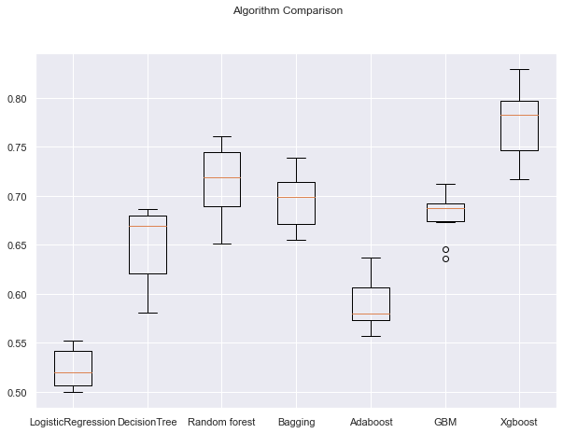
Model Building – Algorithm Comparison – With original data
XGBOOST is giving the highest cross-validated recall followed by RandomForest.
RandomForest and XGBoost can be potential candidates for performance tuning.

Slide 12
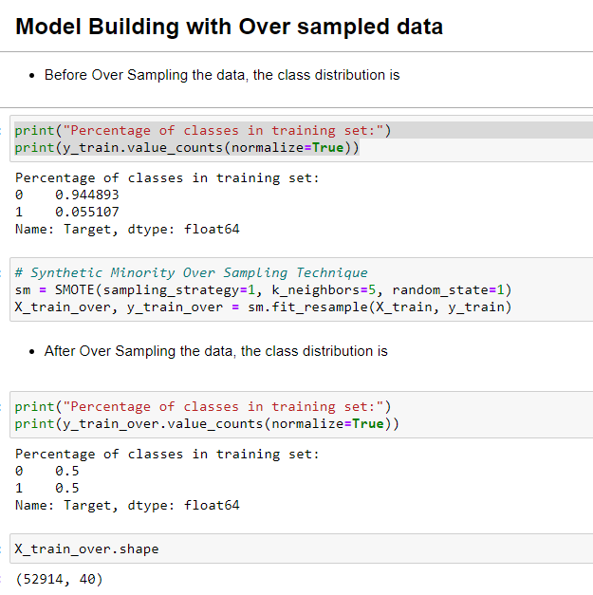
Model Building – With Over Sampled Data
Applying:
Synthetic Minority Over Sampling Technique

Slide 13
Model Building – With Over Sampled Data
Cross-Validation Performance: cv=10
On Training Data
LogisticRegression: 79.40984786587808
DecisionTree: 94.01861217925251
Random forest: 97.1952035999941
Bagging: 95.75355501921703
Adaboost: 83.19322841604645
GBM: 87.28991668797381
Xgboost: 97.58309648832963
Performance on Validation data:
LogisticRegression: 50.536228093120585
DecisionTree: 63.240589198036
Random forest: 80.836820083682
Bagging: 74.88372093023256
Adaboost: 57.79240203410111
GBM: 73.20954907161804
Xgboost: 80.66805845511482

Slide 14
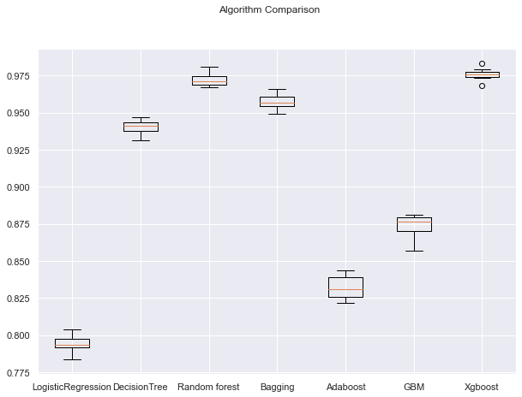
Model Building – Algorithm Comparison – With Over Sampled Data
XGBOOST is giving the highest cross-validated recall followed by RandomForest.
RandomForest and XGBoost can be potential candidates for performance tuning.

Slide 15
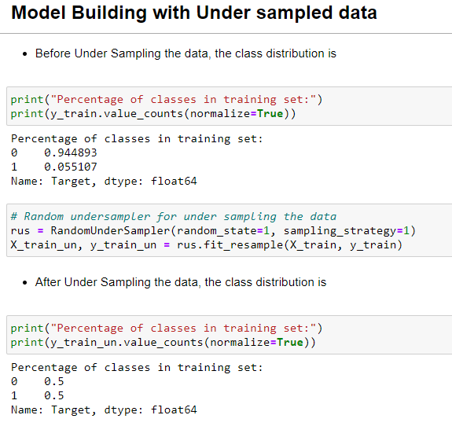
Model Building – With Over Under Sampled Data
Applying:
Random under sampler for under sampling the data

Slide 16
Model Building – With Under Sampled Data
Cross-Validation Performance: cv=10
On Training Data
LogisticRegression: 77.96837541564223
DecisionTree: 77.62112457810912
Random forest: 84.84438354374095
Bagging: 81.74829074330015
Adaboost: 80.08772346318565
GBM: 83.40938371506861
Xgboost: 84.87637818095986
Performance on Validation data:
LogisticRegression: 48.80020207123011
DecisionTree: 45.967166309778726
Random forest: 71.92851824274014
Bagging: 67.01352757544224
Adaboost: 53.28185328185329
GBM: 65.33648968549205
Xgboost: 75.1458576429405
There is an overfitting on almost all the models.

Slide 17
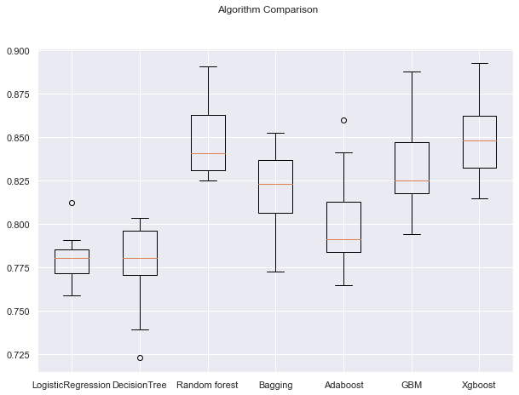
Model Building – Algorithm Comparison – With Under Sampled Data
XGBOOST is giving the highest cross-validated recall followed by RandomForest.
RandomForest and XGBoost can be potential candidates for performance tuning.

Slide 18
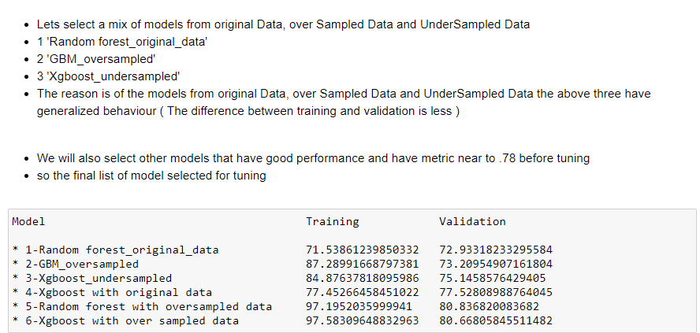
Model Selection

Slide 19
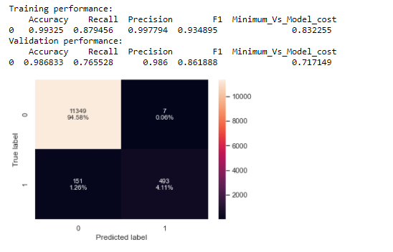
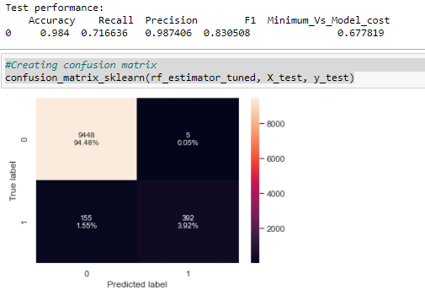
1- Random Forest - With Original Data - Tuning

Slide 20
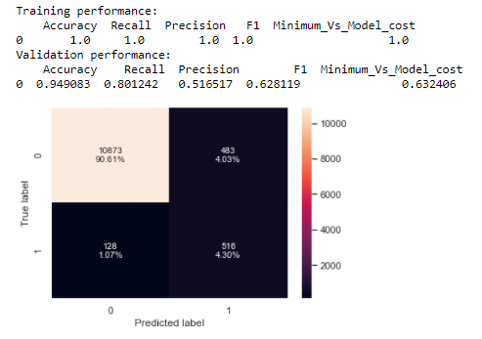
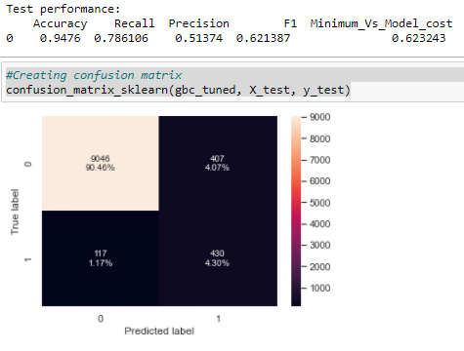
2-Gradient Boost Classifier - With Oversampled Data - Tuning

Slide 21
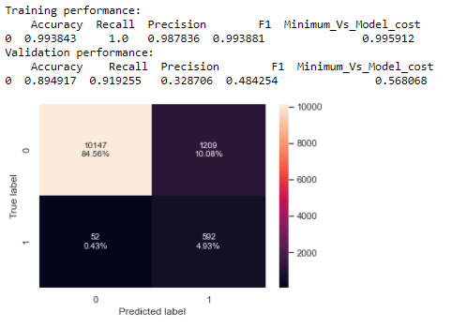
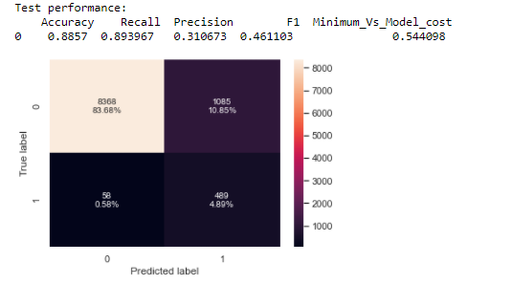
3- Xgboost Classifier - With Under Sampled Data - Tuning

Slide 22
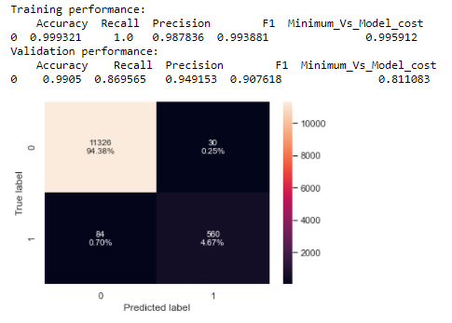
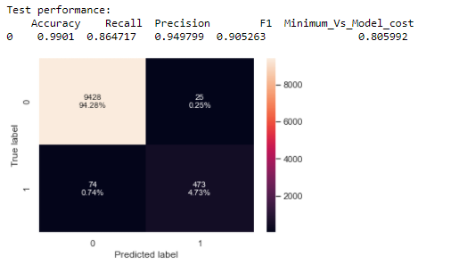
4- Xgboost with original data - Tuning

Slide 23
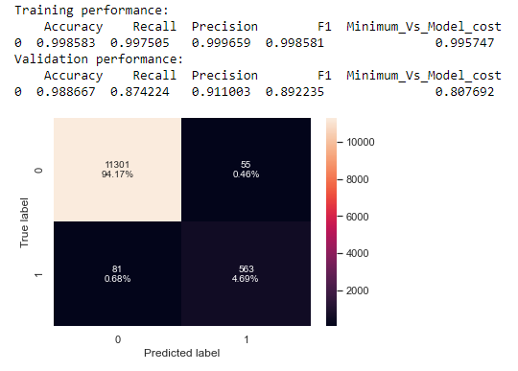
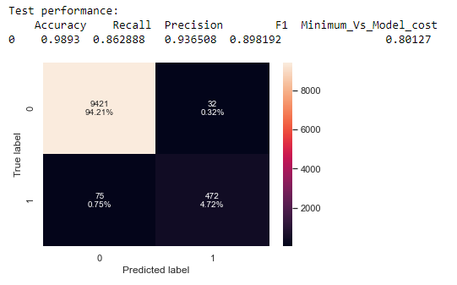
5- Random forest with over Sampled Data - Tuning
This model gives somewhat balanced performance and the metric is more than .78

Slide 24
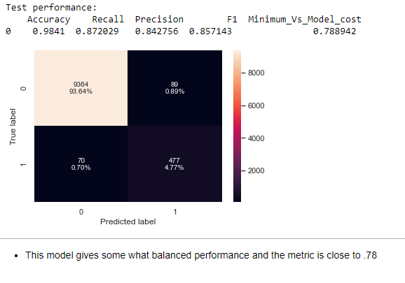
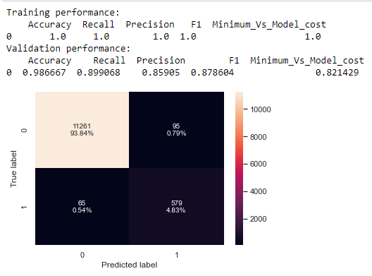
6- Xgboost with over sampled data - Tuning

Slide 25
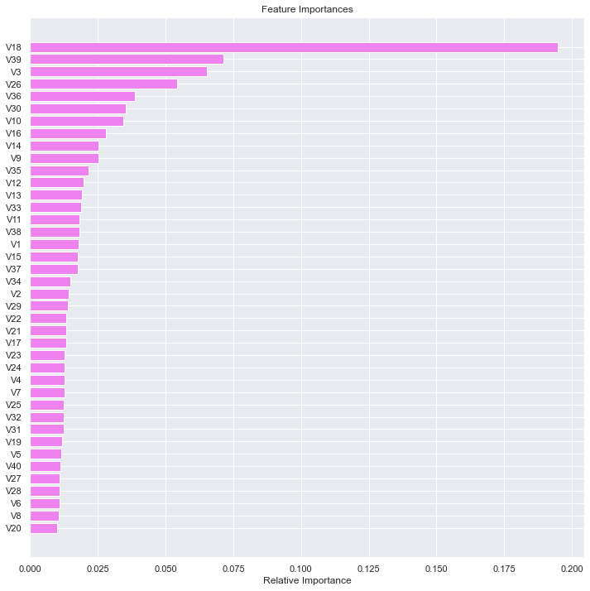
Feature Importance: Xgboost with original data
Variable V18 is the important feature

Slide 26
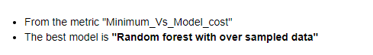
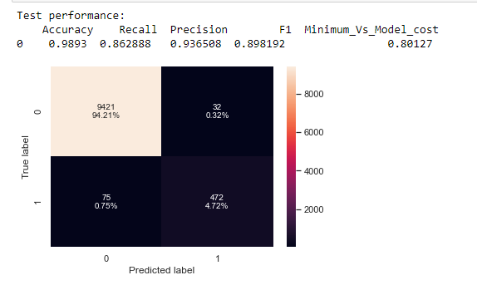
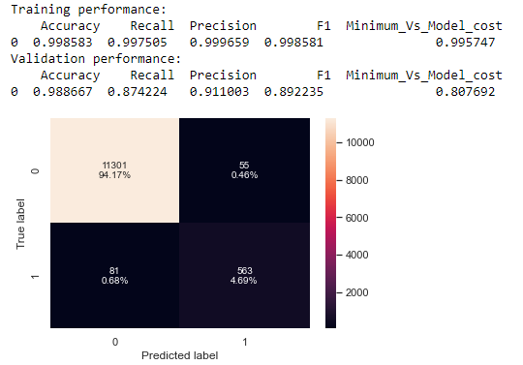
Model Performance comparison & choosing the final model

Slide 27
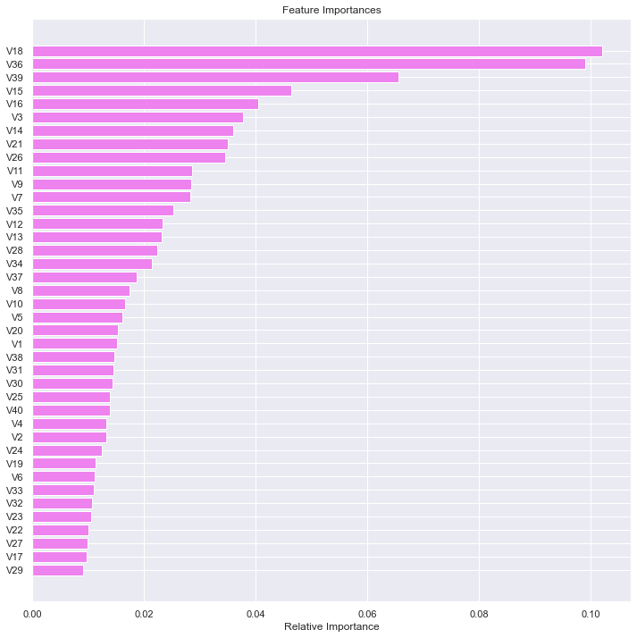
Feature Importance: Random forest with over sampled data
Variable V18 and V36 are import features that determine the failure and helps to minimize the cost.

Slide 28
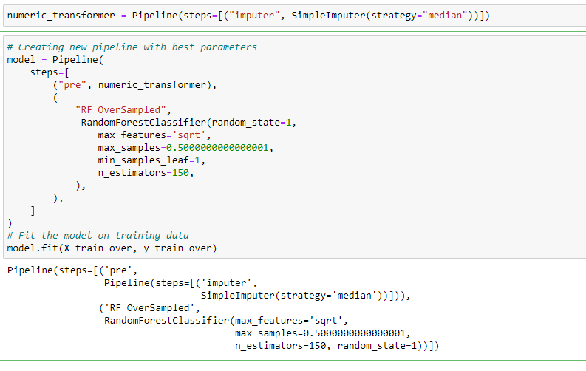
Pipelines to build the final model

Slide 29
Business Insights and Recommendations
Variable V18 and V36 are the important features.
From the model performance in test set, there is an 80% probability that failures can be identified.
Both the models that have more than .78 performance on test data, exhibit overfit, thus the performance in real time might be impacted.
Since the ratio of the failure class is less, more data can be collected on the failure class.

